Slide 1
Network Security
CS 6823 - Lecture 1
Security Basics
Phillip Mak
pmak@nyu.edu

Slide 2
Lesson Objectives
Define and explain basic security terminology
Explain how vulnerabilities in one system affects another system
Define the difference between Asset Owner and IT Asset Owner
Perform Quantitative risk assessment
Understand attack trees

Slide 3
Network Security
Most topics in Computer Science are focused on achieving a desired behavior
Computer and Network Security is focused on preventing undesired behavior
Need to think differently
Paranoia is actually a good thing!
Enemy is going to try and find a input or state in your system which allows for a circumvention of protection measures.
Notes:
e.g., a web server is meant to serve pages, not for hosting malicious content
Understand concepts to make Database perform the desired operations
“create DB for a web app” vs. “ensuring company data doesn’t leak to unauthorized personnel”
It may take only one bufferoverflow for a webserver to be taken over
Example: malicious email, or infecting VPN computer

Slide 4
Think Differently
Security Mindset
What is the system designed to do? What is the proper operation?
The system is typically larger than just the computer or network. However for the purposes of this course we will focus on these parts. (Others, physical, human behavior)
What are the vulnerabilities in the system? How can this system be attacked?
How can the system be defended?
Is the cost of the defense worth it? -Important concept!
Notes:
Systems also need to not do what they’re not supposed to do
Systems tends to have multiple components controlled by different parties
Thinking differently: vulnerabilities in the system of systems
Time/cost analysis of attacking or defending a system

Slide 5


Simplistic View on Password Authentication
Password

Slide 6


Reality – Larger System in Play
Password Recovery:
Prompt for High School
Password
Social Networks
Social Engineering
Attacker

Slide 7
Attack on Wired Magazine Writer 2012 (1 of 3)
Attacker’s goal was to take the targets twitter handle @mat
Could directly attacker Twitter’s authentication but…
Attacker found from the Twitter page the personal home page of the account holder
There he found his gmail address
Went to Google’s account recovery page
The recovery page showed that he had an alternate email ending in @me.com
Attacker new he could recover a @me.com email with just the billing address and last four digits of the associated credit card
Full details from the author

Slide 8
Attack on Wired Magazine Writer 2012 (2 of 3)
Attacker could get credit card info from a “loophole” in Amazon
Call Amazon and tell them you are the account holder and want to add a credit card. To do this the attacker just needs the email and billing address of the account holder.
Got billing address since the victim registered a domain name for his website.
Call back Amazon and indicate you lost access to your email account. Provide name, address and the new cc#
Amazon sends account info to new email address held by attacker

Slide 9
Attack on Wired Magazine Writer 2012 (3 of 3)
Attacker then could login and see last four digits of original cc#.
Went back to Apple and took over @me and iCloud account (which are linked)
Since @me was recovery email from Google and Twitter the attacker now took over those accounts as well.
Wiped victims computer remotely using iCloud “feature”
What are the bounds of this security system?
Notes:
Lessons:
Weakness in one system can affect another independent one

Slide 10
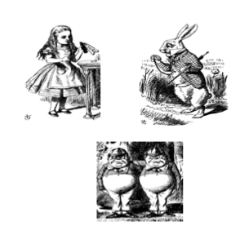
The Cast of Characters
The Cast of Characters
Alice and Bob are the good guys
Trudy is the bad guy (gal)
Stands for “Intruder”

Slide 11

CIA - You will see this in many textbooks
Confidentiality - keeping information secret from unauthorized users
Integrity - insuring that the information is genuine and hasn’t been tampered with.
Availability - ensuring that the system is always available.
Also add:
Authenticity – determining the origin of data – Type of Integrity
Non-Repudiation – proving the integrity and origin – Type of Integrity
Good way to frame the problem.
But security is far more complex.
Confidentiality
Availability
Security
Objectives
Integrity

Slide 12
Alice’s Online Bank
Alice opens Alice’s Online Bank (AOB)
What are the security concerns for:
Alice (the bank)
Bob (the user)
Trudy (the attacker)
Think about CIA-AN for each
Notes:
Qs we’ll going to discuss

Slide 13
CIA – on Alice’s Online Bank (Example)
Confidentiality: prevent unauthorized reading of information
AOB) must prevent Trudy from learning Bob’s account balance
Bob doesn’t want the wrong people knowing his account details
Integrity: prevent unauthorized changing of information
AOB must know what the account information is, and must prevent or detect tampering
Bob must not be able to improperly change his own account balance
Trust must not be able to change Bob’s account balance
Availability: Data is available in a timely manner when needed
AOB’s information must be available when needed
Bob must be able to make transaction
If not, he’ll take his business elsewhere

Slide 14
Beyond CIA
How does Bob’s computer know that “Bob” is really Bob and not Trudy?
Bob’s password must be verified
This requires some clever cryptography
What are security concerns of pwds?
Are there alternatives to passwords?
Notes:
Stringent password requirements
Something You Know/Have/Are

Slide 15
When some says “Their Network is Secure”
What does this mean?
Definition of Security – “Freedom from Risk or Danger” Random House Unabridged Dictionary
Is it 100% protected against every conceivable threat?
No
Is it impossible to attack and compromise
No
Most of the time it means:
The network has been designed so as to maintain an acceptable level of risk.

Slide 16
Security is an engineering trade-off
The objective is typically not to make the system secure against every threat.
Instead the goal is to optimize the security of the system given certain constraints (cost, end user usability, information sensitivity)
Notes:
Complexity of attack / layers of protection

Slide 17
Security is an ongoing process - not a product
If a vendor comes to you and says that their “box” will secure your network - run!
Security requires not only technical countermeasures and tools but processes and procedures.
Once a tool, process or procedure is put in place it must be continuously revisited.
SECURITY IS PRIMARILY ABOUT RISK MANAGEMENT
Notes:
IDS box, FW box, some monitoring tool

Slide 18
General Concept of Risk Analysis and Management
A risk consists of something of value (an “asset” at risk) which may lose value if a negative event occurs.
A threat to a system is any potential occurrence, malicious or otherwise, that can have an adverse effect on the assets and resources associated with the system.
A vulnerability of a system is some characteristic that makes it possible for a threat to occur.
An attack (exploit) on a system is some action that involves exploitation of some vulnerability in order to cause an existing threat to occur.
Risk analysis is the process of:
Identifying the assets at risk
Putting quantitative or qualitative measures on the likelihood of the event happening
Putting quantitative or qualitative measures on the consequences of the potential loss (also called impact)
Risk Management is a process for planning on how to control those risks
Notes:
quantitative – with numbers/objective
qualitative – subjective
e.g. AOB

Slide 19
Non-IT Example 1: Driving risk
Assets at risk: people’s lives and health, the automobile, other property
Negative event: auto accident
Risk Management:
Risk avoidance: Don’t drive or just not driving on snowy days
Risk mitigation: Seat belts, air bags, “crumple zones” in auto design, following DWI laws, defensive driving techniques, ABS, driving slow
Risk transfer: insurance
Risk acceptance: residual risk of injury, deductible on insurance
Notes:
Asset: mental health, stress
Reduction / mitigation (if it still happens…) / transfer (not my problem) / acceptance: low enough anyway

Slide 20
Information Security Risk Concept
Vulnerability
Information Asset
At Risk
Threat (attacker)
Risk analysis starts with understanding what assets are potentially at risk, what the threats are. This forms the basis for finding the “sweet spot” of putting in enough security for to protect the value of the assets.

Slide 21
Information Security Risk Analysis
Example: in a system that uses personal information such as name, SSN, etc., “Identity theft” is a risk. The related IT asset at risk is the confidentiality of that information. The impact of a compromise is the potential for identity theft.
Example: in a battlefield communications system, human lives are at risk if the system cannot be used to call in support. The related IT asset is the availability of the system, and the impact of a failure is potential for loss of life
The risk management strategies that we consider are for the IT assets, but the impact is based on the real assets
Notes:
Fantasy football site: availability

Slide 22
Asset Owner vs. IT Asset at Risk Owner
The owner of the asset may not be the owner of the related IT asset at risk:
Example: an “identity” that may be stolen is an asset of that person, but the related IT asset (SSN, etc.) is under the control of many other entities.
Example: a civilian undercover agent (spy) transmits information to which only he has access back to a military organization. If that military organization’s system is compromised, the agent’s life may be at risk
If the owner of the IT system does not suffer the impact of a compromise, what is the motivation to pay for the needed controls for proper risk management?
Example: Target was breached by hackers between Nov 27 – mid-Dec and personal information for 70-110 million people were stolen. The potential impact of each compromise was on the credit card holders (fraud, identity theft), Target, and the credit/debit card companies (which cover all fraudulent transactions above $50 per account by law).
Laws and policies are required so owners of IT assets include it in their risk analysis and risk management
Notes:
BREAK
The owner of the asset is not the owner of the IT asset
Rules, laws, and policies need to be accounted for
IT assets include people, processes, functions, and the actual system

Slide 23
RISK ASSESSMENT

Slide 24
Risk Assessment
Assessment: measures the impact of an event, and the probability of an event (threat agent exploiting a vulnerability)
Quantitative (objective) and Qualitative (subjective) approaches both used.
Quantitative approach:
Compute expected monetary value (impact) of loss for all “events”
Compute the probability of each type of expected loss
Qualitative approach: use Low, Medium, High; ratings; other categorical scales
Notes:
This entire course can be thought as risk analysis and management
Risk management approach – ground vehicles

Slide 25
Risk Management
Remove the risk (risk avoidance) - Remove the system component or feature associated with the risk if the feature is not worth the risk.
Mitigate the risk - Reduce the risk with countermeasures.
Transfer the risk – Transfer to somebody else via insurance, warnings etc.
Accept the risk – Risk is low but costly to mitigate - worth accepting. Monitor.
The understanding of risks leads to policies, specifications and requirements.
Appropriate security mechanisms are then developed and implemented.
Notes:
Give examples of each

Slide 26
Quantitative - Security Cost Risk Assessment
Exposure Factor (EF) = Percentage of asset loss caused by identified threat
Single Loss Expectancy (SLE) = Asset Value X Exposure Factor
Annualized Rate of Occurrence (ARO) = Estimated frequency a threat will occur within a year
Annualized Loss Expectancy (ALE) = SLE x ARO
Notes:
With numbers
ALE = how much you’ll lose per year, so how much should be used to safeguard it?
EPA- $9.1 Million; FDA- $7.9 Million

Slide 27
Example:
Fire Damage to a building:
Asset Value: value of the building - $750,000
Single Loss Expectancy (SLE: Asset Value x Exposure Factor) - $250,000 (damage caused by the fire)
Annualized Rate of Occurrence (ARO) - .05 (5% chance every year that there will be a fire)
Annualized Loss Expectancy (ALE: $250,000 x .05) = $12,500
So does a fire alarm system which costs $5000 to install and maintain yearly worth it?
YES - Fire Alarm Cost < ALE

Slide 28
Network Security Example:
Credit Card database stolen from online retailer via SQL injection:
Asset Value: Here the asset value is a bit nebulous so it sometimes is better to focus on the SLE
Single Loss Expectancy (SLE): If the database is stolen and/or damaged how much is it going to cost the company in PCI fines, lost business, consulting fees for security, etc. $1M is not unreasonable for a medium sized retailer.
Annualized Rate of Occurrence (ARO) - Can get this information from network consulting organizations or your insurance company. 5%
Annualized Loss Expectancy (ALE)= $1Mx.05=$50,000
So does a web firewall which costs $24K make sense? Most likely, YES

Slide 29
Quantitative: Useful or Not?
Pros:
Objective, independent process
Credibility for audit, management (especially corporate management)
Solid basis for evaluating cost/benefit of countermeasures
Quantitative risk assessment is the basis for insurance, risk managed portfolios, etc.
Cons:
In most cases, it is difficult to enumerate all types of events and get meaningful data on probability and impact
Very time consuming, costly to do right
Many unknowns may give a false sense of control
Not reliable for “rare” events or “unthinkable” impacts

Slide 30
Qualitative Approach – Establish Impact
Rather than have specific numbers, Establish classes of loss values (“impact”), such as:
Low, medium, high
Under $10K, between $10K and $1M, over $1M (used by at least one company)
Type of loss (e. g. compromise of credit card #, compromise of SSN, compromise of highly personal data)
Minor injury, significant injuries, loss of life, large scale loss of life (used by emergency response organizations to categorize non-IT events)
Rank ordering

Slide 31
Qualitative Approach – Establish Likelihood
Establish classes of likelihood of compromise
Low, medium, high likelihood
Decide on a risk management approach to each combination of (class of loss, likelihood of loss)
Focus effort on medium to high loss and/or medium to high likelihood items

Slide 32
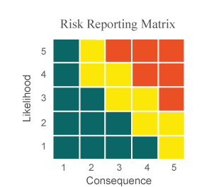
Risk Matrix
Level | Likelihood | Probability of Occurrence
5 | Near Certainty | ~ 90%
4 | Highly Likely | ~ 70%
3 | Likely | ~ 50%
2 | Low Likelihood | ~ 30%
1 | Not Likely | ~ 10%
Level | Consequences
5 | Severe
4 | Significant
3 | Moderate
2 | Minor
1 | Minimal or no consequences

Slide 33
Example Risk Matrix (from the DoD)
Example Risk #1: The software is really buggy and will likely have buffer overflow vulnerabilities.
Example Risk #2: There’s a 70% chance the website will be hacked and one million credit card numbers will be lost.
#2
#1

Slide 34

Mitigating Risk
Example Risk #1: The software is really buggy and will likely have buffer overflow vulnerabilities. Reduce the likelihood of this risk by spending more resources to reduce defects.
Example Risk #2: There’s a 70% chance the website will be hacked and 1 million credit card numbers will be lost. Reduce consequences by not storing full credit card numbers. Likelihood reduced by adding a web firewall.
#2
#1
Residual risk is the remaining risk after mitigations

Slide 35
ATTACK TREES (THINK LIKE AN ATTACKER)

Slide 36
Attack Trees
Another way to visualize the current security posture of a system
Helps to indentify the most vulnerable areas of the system and where to apply resources.
A method of building a database which describes the security state of the system
Attack Trees Section/Slides
Reference: Attack Trees SANS 99 – Bruce Schneier

Slide 37
Attack Trees – How do they Work?
Represents the attacks and countermeasures as part of a tree structure
Root node is the goal of the attack. In a complex system there is probably many root nodes or goals.
Leaf nodes are the attacks

Slide 38
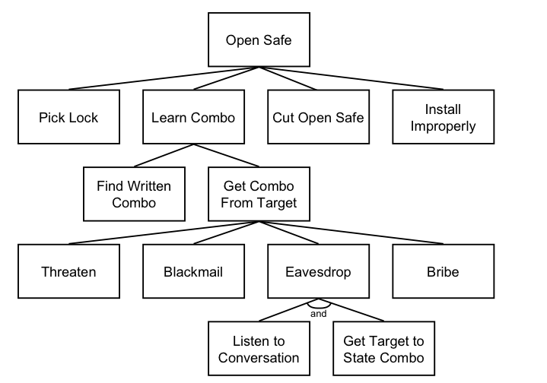
Basic Attack Tree

Slide 39
AND Nodes OR Nodes
“OR” nodes represent different ways of achieving the same goal
To break into a house you can pick the lock or break the window
“AND” nodes represent different steps in achieving a single outcome.
To enter a window you need to break the windows AND climb through the opening.

Slide 40
Boolean Node Values
Once the tree is created Boolean values can be assigned to each node.
Example: probable vs. improbable

Slide 41
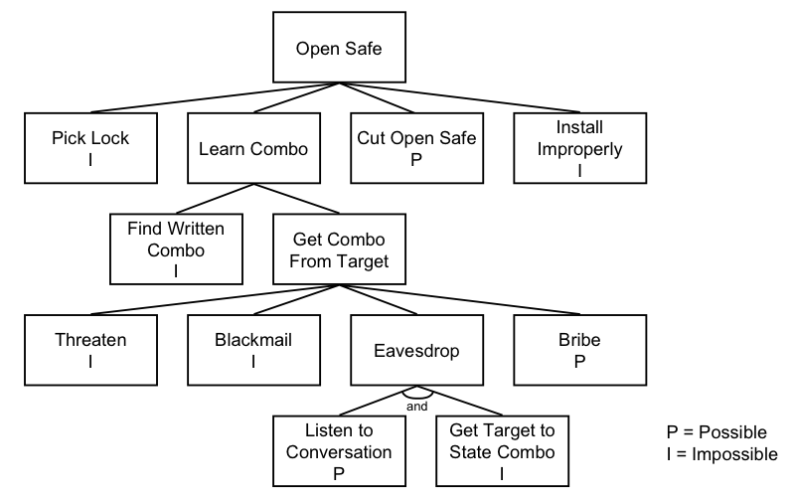
Possible vs. Impossible Node Values

Slide 42
Other Possible Boolean Node Values
Easy vs. Not Easy
Expensive vs. Not Expensive
Intrusive vs. Non-Intrusive
Legal vs. Illegal

Slide 43
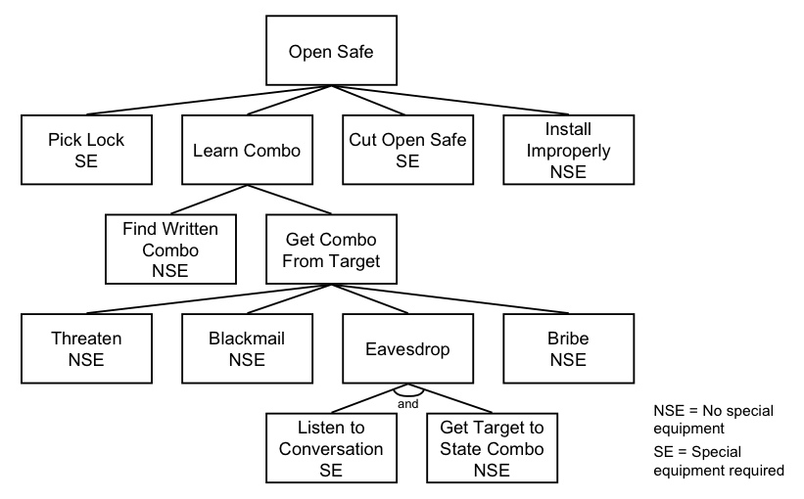
Special Equipment Needed

Slide 44
Continuous Node Values
Cost in $ to attack or defend
Time to achieve goal
Cost in resources to attack or defend

Slide 45
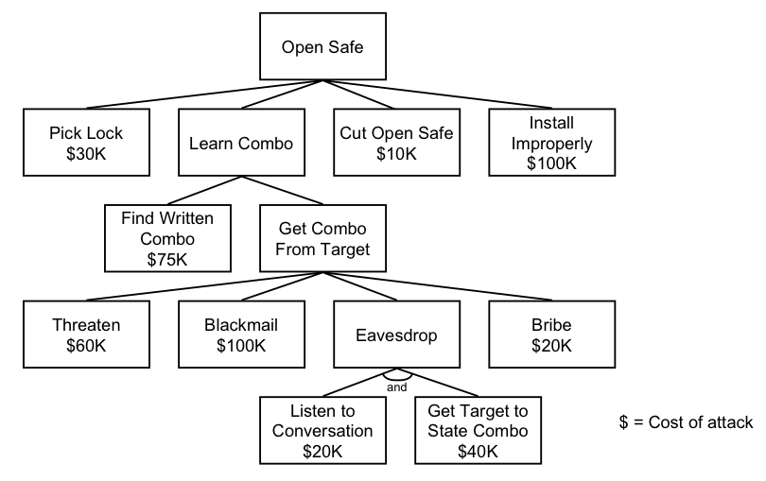
Cost of an Attack

Slide 46
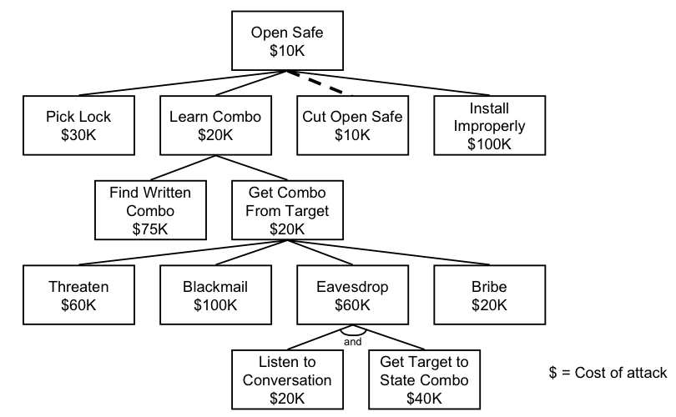
Cheapest Attack
Notes:
Test Note

Slide 47
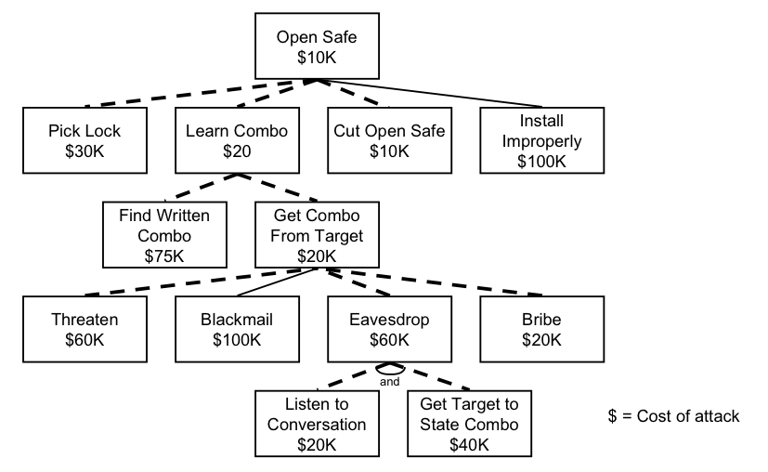
Attacks Less than $100K

Slide 48
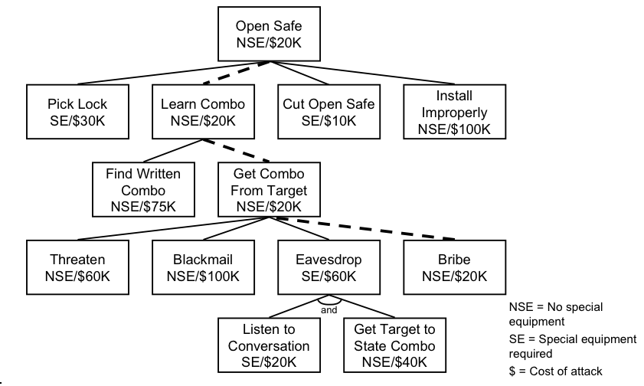
Cheapest Attack Requiring No Special Equipment

Slide 49
Applying a Countermeasure – Cheapest NSE now $60K

Slide 50
Tree Construction
1) Identify Attack Goals. Each Goal is a separate Attack Tree
2) Identify attacks against these goals
3) A database of attack trees can be developed and resused (plugged in)
Notes:
Go through with the class an attack tree based on current events. Bomb on plane/airport security.

Slide 51
Example – ACME Enterprises
Notes:
Goal: get proprietary secrets
- dumpster diving, or steal garbage
- emanation: scout, get equiptment, monitor
- get insider: plant or recruit
- get physical access
- attack via network
- get access to web server
- domain name/FW/OS details/scan for vulberabilities
- telephone

Slide 52
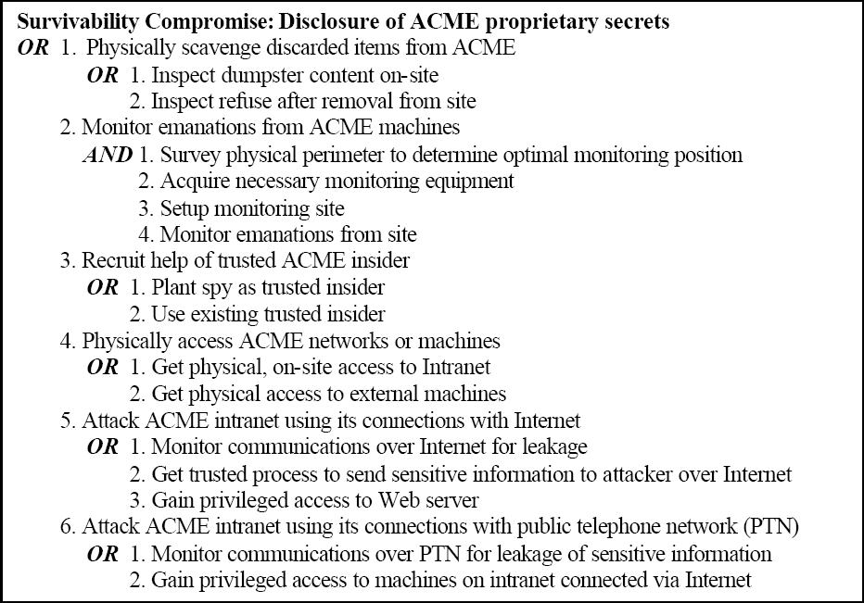
ACME High Level Attack Tree

Slide 53
ACME – Expansion of Node

Slide 54
Need to Stay Current!
Subreddit on Information Security
https://www.reddit.com/r/netsec/
Warning: Contains lots of click bait and misinformation
SANS @RISK Newsletter
https://www.sans.org/newsletters/at-risk/

